Slide 1

The Shape of a City
Applications of Urban Data Science in Housing and Land Use
Notes:
Shanghai

Slide 2
About Me
Marley Buchman, Economist at ECONorthwest
ECONorthwest is an economic consulting firm based in the pacific northwest (all views expressed in this presentation are my own and do not reflect the views of ECONorthwest)
My work is focused on policy analysis related to questions of housing and land use
I’m also an organizer of the Portland R Meetup

Slide 3
What is Urban Data Science?
Application of the Data Science toolkit to social science research questions (economics, sociology, criminology, urban planning, transportation planning, etc.)
Typically there is a large spatial component to the analysis/research
Notable Python Libraries: PySAL, GeoPandas, Fiona, OSMnx

Slide 4
Outline
Why do cities look the way they do?
Motivations for housing and land use policy research
What is housing and land use policy research?
Questions

Slide 5
Key Definitions
Proforma - A proforma analysis is a set of calculations that projects the financial return that a proposed real estate development is likely to create.
Development Feasibility – An analysis of whether a potential development project meets the technical and legal requirements to occur, as well as producing an expected financial return above a predetermined threshold
Source: PlannersWeb

Slide 6
Why do cities look the way they do?

Slide 7
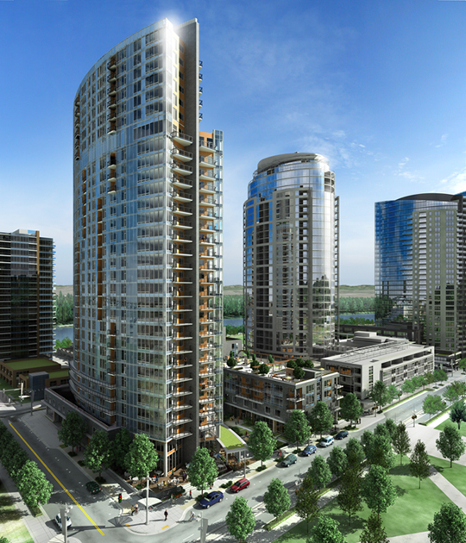

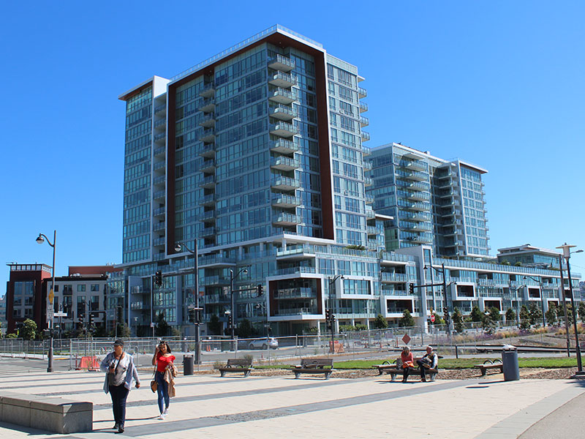
Where in the world are these buildings?
Source: Wikimedia, SF Weekly

Slide 8
Do these places look like this because architects think this is beautiful?

Slide 9
Not Really

Slide 10
Markets Shape Cities
Development feasibility is determined by market conditions (supply/demand)
Land use and housing policy affects development feasibility
The design of a building is constrained by the economics of development

Slide 11
Key Takeaway
Zoning != Feasibility
Allowing high rise towers within a zoning code does not mean towers will be built
The development needs to be economically viable to occur, thus we see this type of development only in markets with rents that can support it (Manhattan, Shanghai, etc.)

Slide 12

If you’re interested in urban economics and land use planning…

Slide 13
If markets shape cities, then what role does Urban Data Science play?

Slide 14
Markets can produce suboptimal results…

Slide 15
Mapping Inequality

Slide 16
Mapping Inequality
“These grades were a tool for redlining: making it difficult or impossible for people in certain areas to access mortgage financing and thus become homeowners. Redlining directed both public and private capital to native-born white families and away from African American and immigrant families. As homeownership was arguably the most significant means of intergenerational wealth building in the United States in the twentieth century, these redlining practices from eight decades ago had long-term effects in creating wealth inequalities that we still see today. Mapping Inequality, we hope, will allow and encourage you to grapple with this history of government policies contributing to inequality.”
Source: Mapping Inequality

Slide 17
Portland’s 1938 Homeowners’ Loan Corporation Map (HOLC)

Slide 18
Portland’s Zoning (2019)

Slide 19
Portland’s Zoning by HOLC Grade

Slide 21
Politics can produce suboptimal results…

Slide 22
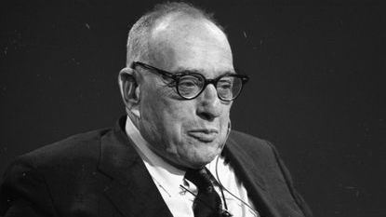
Does anyone know who this is?
Source: NY Daily News

Slide 23

He’s the subject of this book

Slide 24
Power Broker
““They were talking one day about highways and where they got built,” he recalled, “and here were these mathematical formulas about traffic density and population density and so on, and all of a sudden I said to myself: ‘This is completely wrong. This isn’t why highways get built. Highways get built because Robert Moses wants them built there. If you don’t find out and explain to people where Robert Moses gets his power, then everything else you do is going to be dishonest.’ ” -– Robert Caro
Source: NYTimes

Slide 25
How can we use data to make better policy?

Slide 26
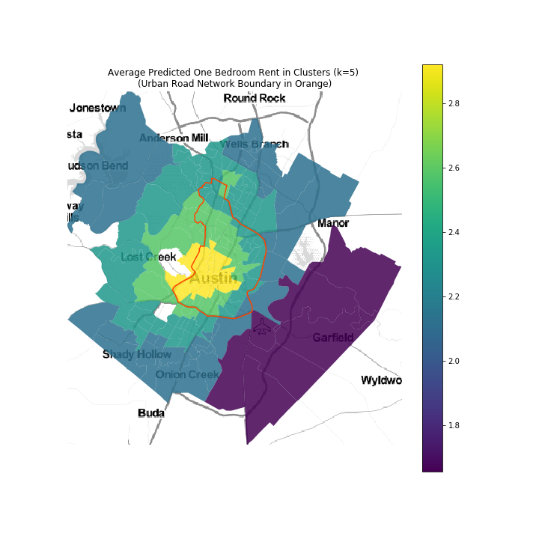
We can use a KNN algorithm to define the boundaries and specifications of a density bonus policy

Slide 27
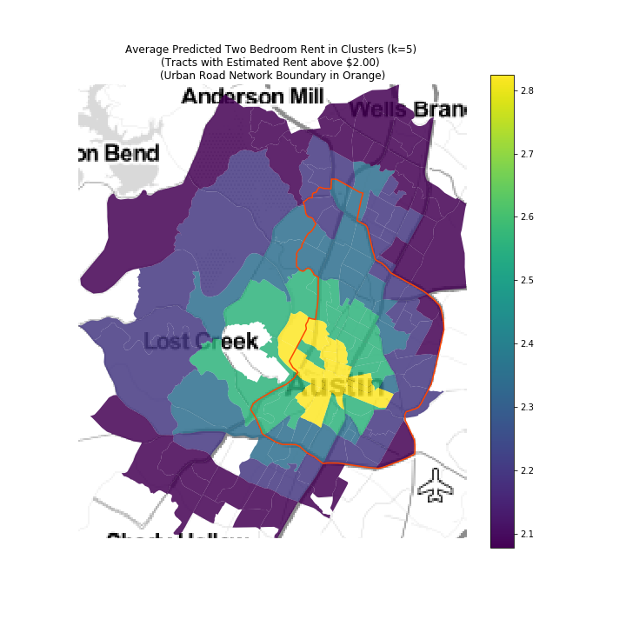
Same example but using two-bedroom rents

Slide 28
Most Common Workflows
Model how a change in a specific policy would affect land use and development
Identify potential policy interventions that would achieve a specific goal as it relates to housing and land use
These analyses rely on proforma modeling, econometric modeling, and machine learning

Slide 29
Policy: T.O.D.
Incentivize housing development in areas with less dependence on personal automobiles for transportation
Transit Oriented Development (T.O.D.)
Environmental benefits along with reduced burden on transportation networks

Slide 30
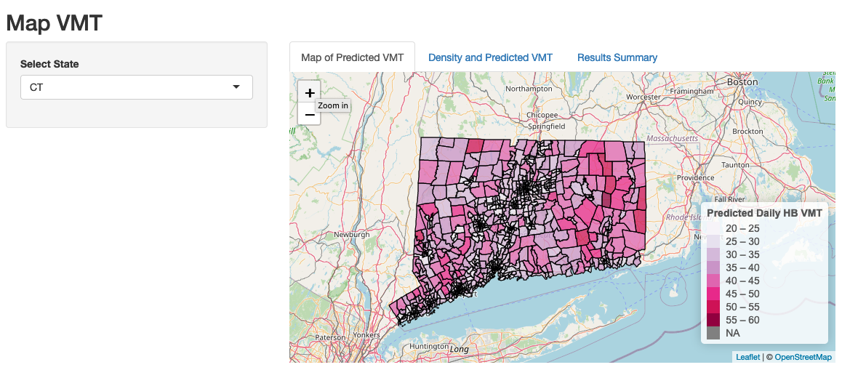
Where are these places?

Slide 31
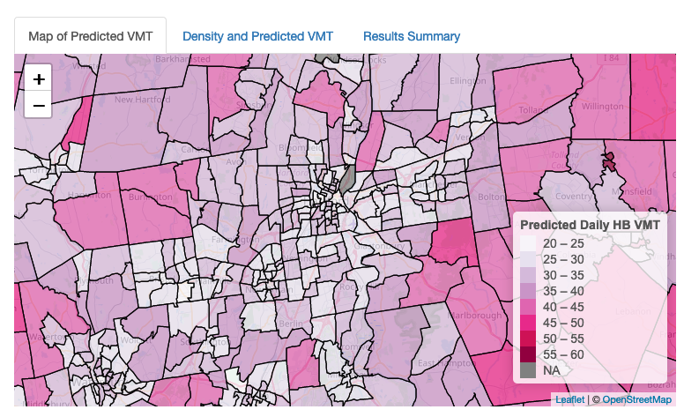
Closer look at Hartford

Slide 32
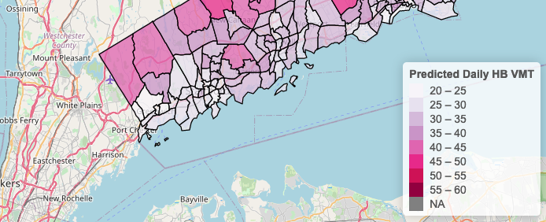
Least amount of miles driven in NYC commute corridor

Slide 33
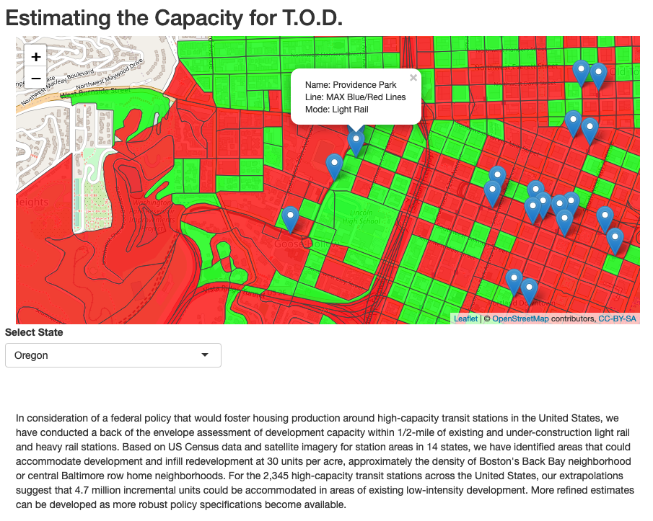
Is there capacity to build more housing?

Slide 34
Policy Goal: Avoid Displacement
Maintain existing stock of affordable housing
Prevent redevelopment of naturally occurring affordable housing (NOAH)
More cost effective than providing new affordable housing units

Slide 36
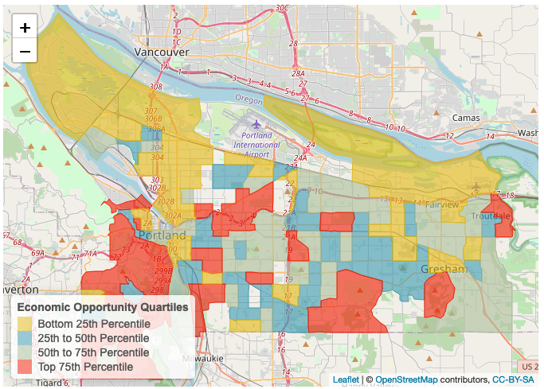
Economic Opportunity Map

Slide 37
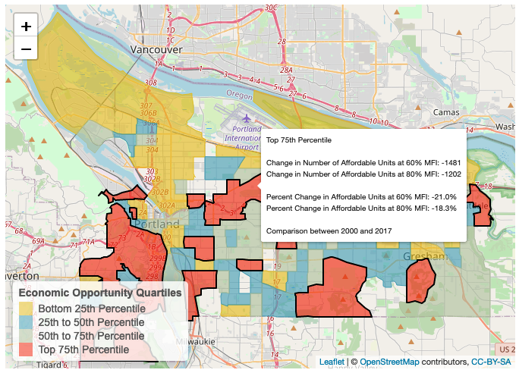
What is the change in NOAH in areas of greatest economic opportunity?

Slide 38
Policy: Residential Infill
Add housing units in existing neighborhoods rather than at the edge of the metro (Residential Infill)
Lower infrastructure investment required (don’t have to extend services to areas currently without services i.e. outside UGB)
Add housing units in neighborhoods with economic opportunity

Slide 39
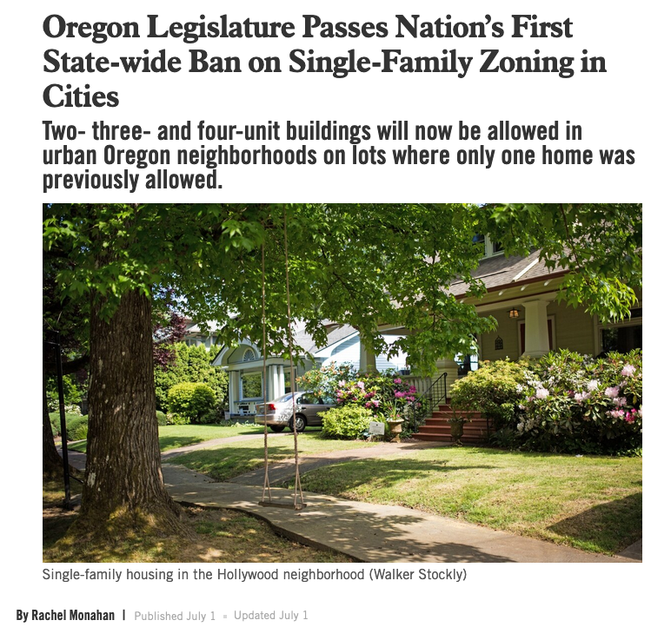
Oregon House Bill 2001
Source: Willamette Week

Slide 40
Remember Zoning != Feasibility

Slide 41
How to estimate impact of HB 2001?
Proforma analysis determines the financial feasibility of a development
Need to run a proforma on every parcel currently zoned single-family residential
Proforma requires an assumption for the future developments rent or sale price

Slide 42
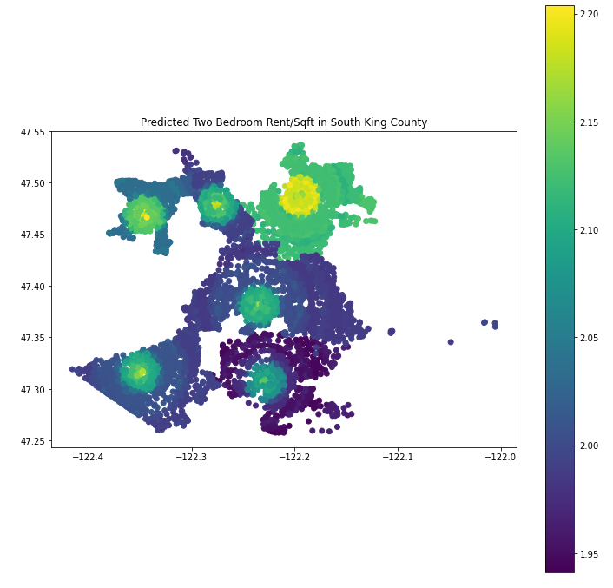
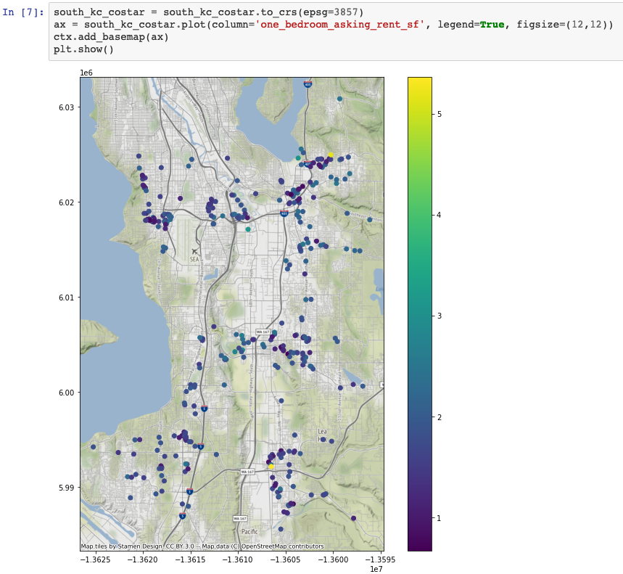
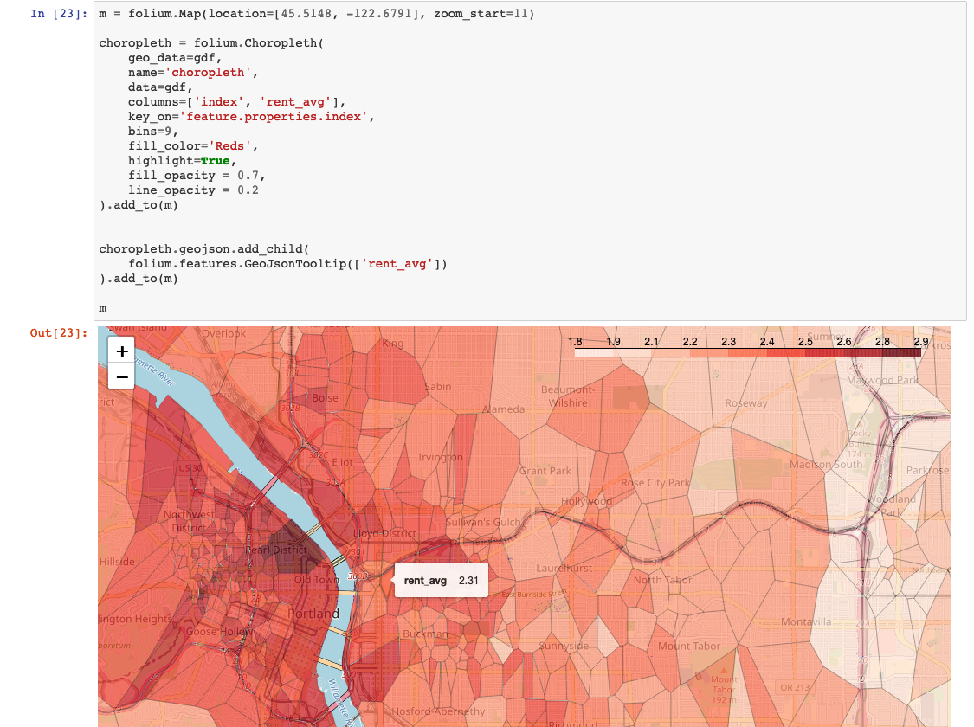
Build Models to Predict Rent and Sale Price

Slide 43
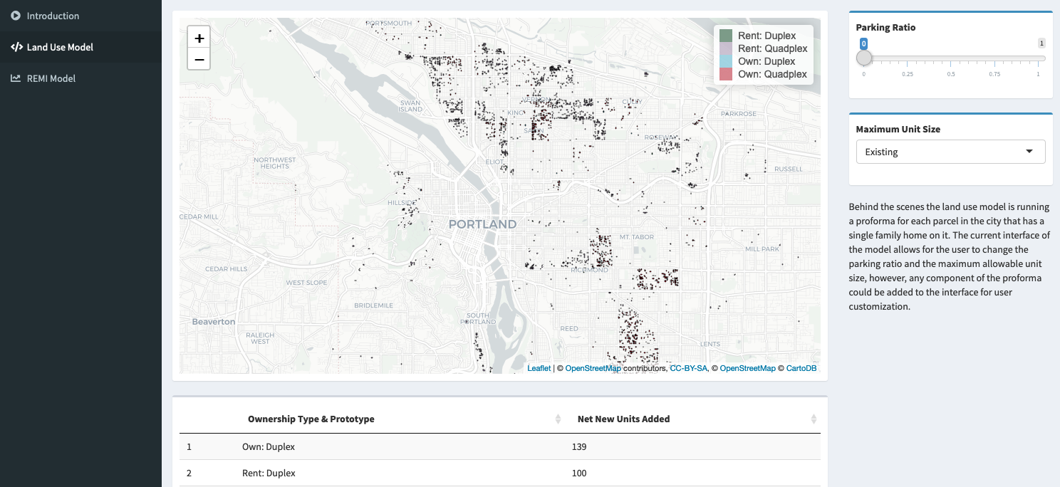
Land Use Model

Slide 44
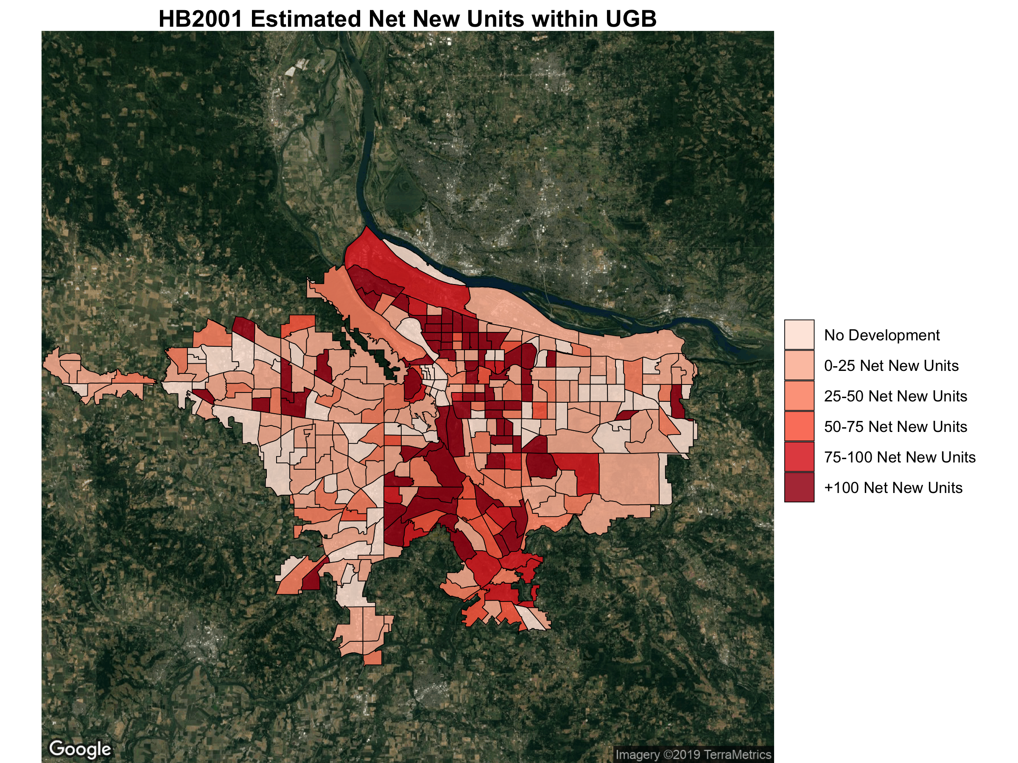

Slide 45
Contact Info
Email: michaelmbuchman@gmail.com
Twitter: @buchmayne
Questions?

Slide 46
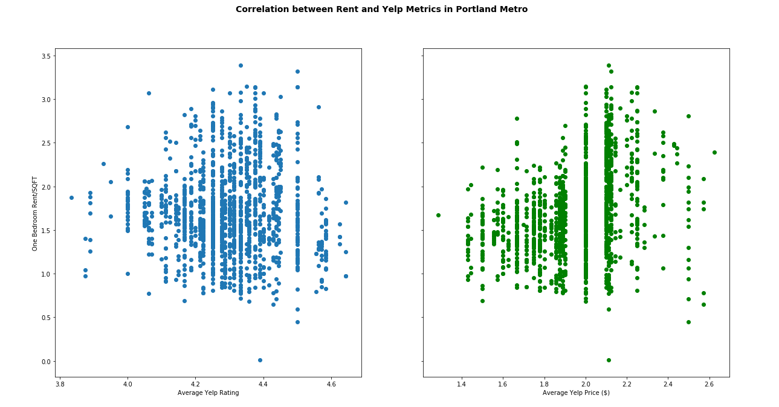
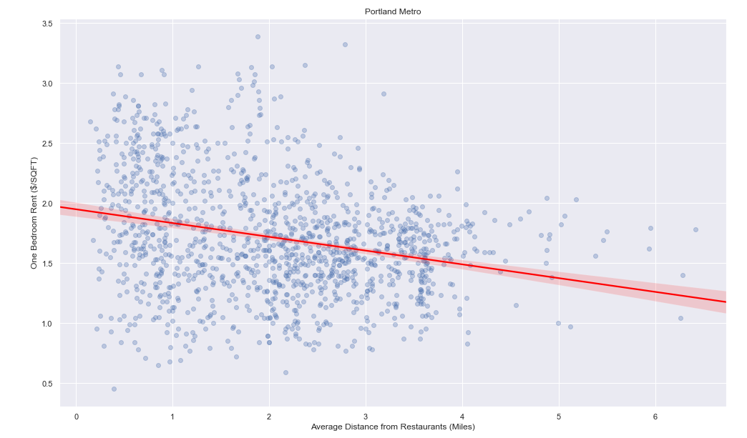
Ad Hoc Yelp Analysis

Slide 47
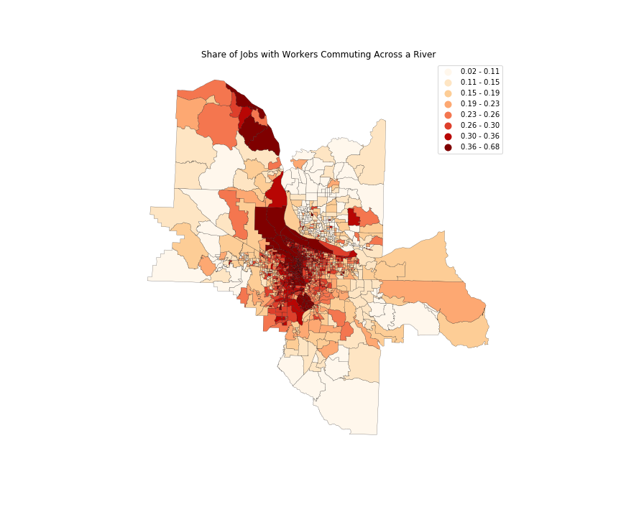

Slide 48
